Slide 1
Code Week SMART SIGNATURE VERIFICATION SYSTEM
Team Name: Driving Insights
Team Member: Sushmita Mitkar

Slide 2

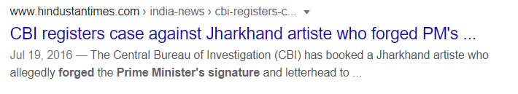
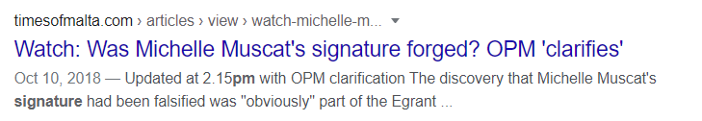
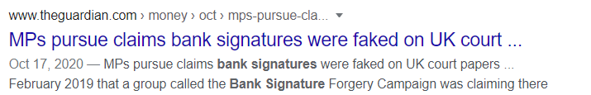
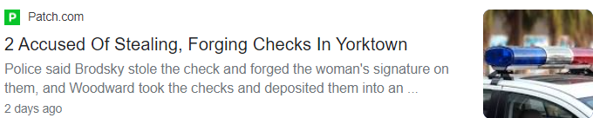
Motivation

Slide 3
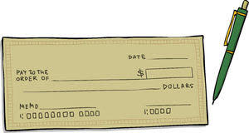
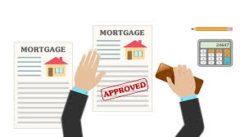
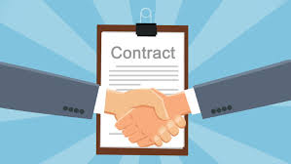
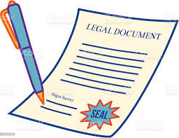
Signature Verification
Checks Loan and Mortgage Business Contracts Legal documents
Problems while verifying signatures manually
Increase in human efforts
Time consuming
Human Error
Thought of AI?
A single machine can process :7.5 checks minute * 24 HOURS *60 MINUTES = 10800 checks a day

Slide 4

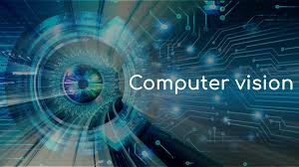
Why AI based smart signature verification?
Digital Banking
Lesser chances of forgery
Automation and reduced manual efforts
Solution
Artificial Intelligence + Computer Vision
Deep Neural Networks Image Processing and Text Extraction
for signature feature
extraction

Slide 5

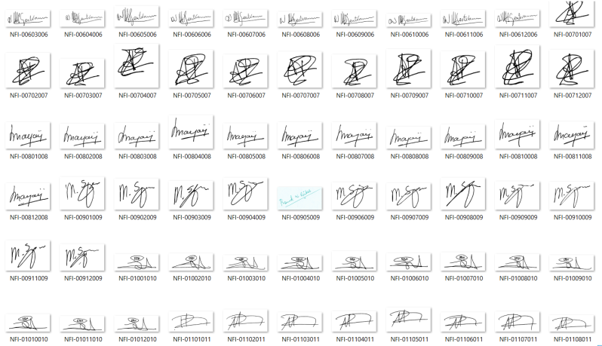
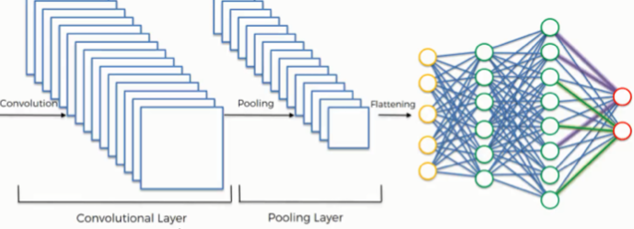
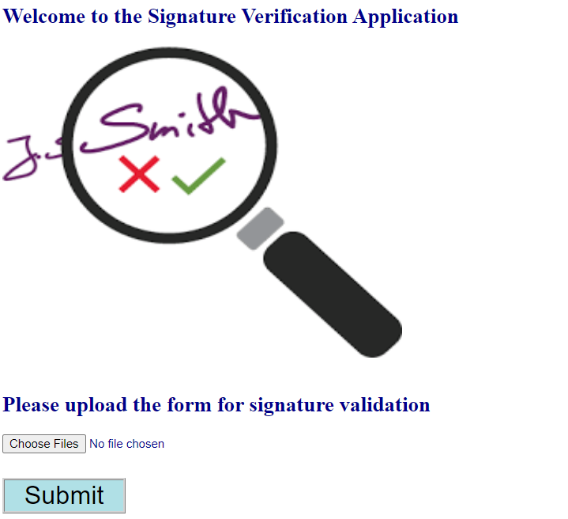
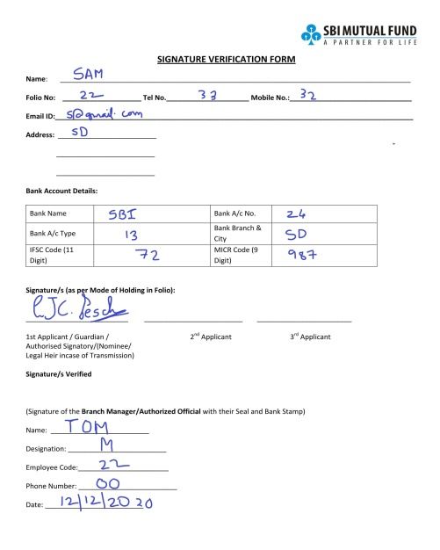
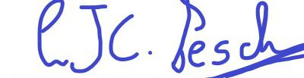
Framework
Convolutional Neural Network
Step 1: Model Training
Step 2: Model Testing
Trained Signature Classification Model
Validation
Result
Upload Document
Signature to Validate

Slide 6
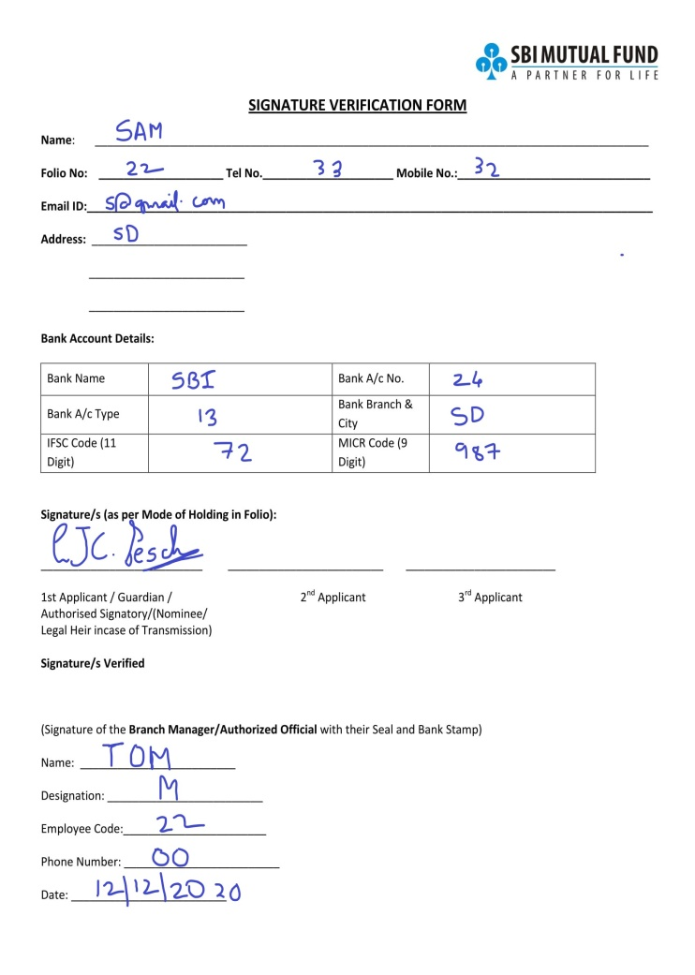
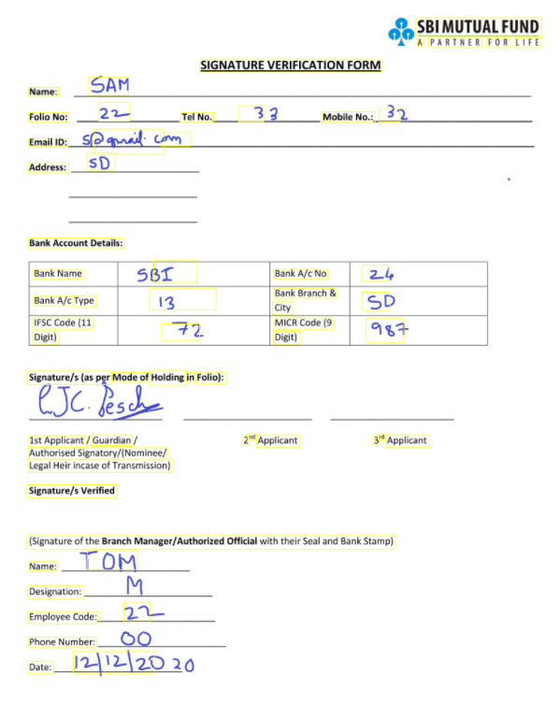
Optional Character Recognition
Original Document
Text Extraction
Extracted Details
Username: SAM
Bank A/c No : 83
Bank Branch: NP
IFSC code:
823
Signature to Validate

Slide 7
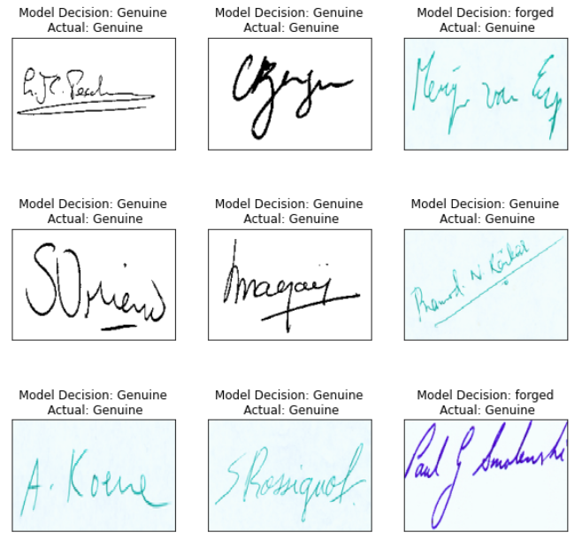
Model Predictions
All the below test signatures are Genuine

Slide 8
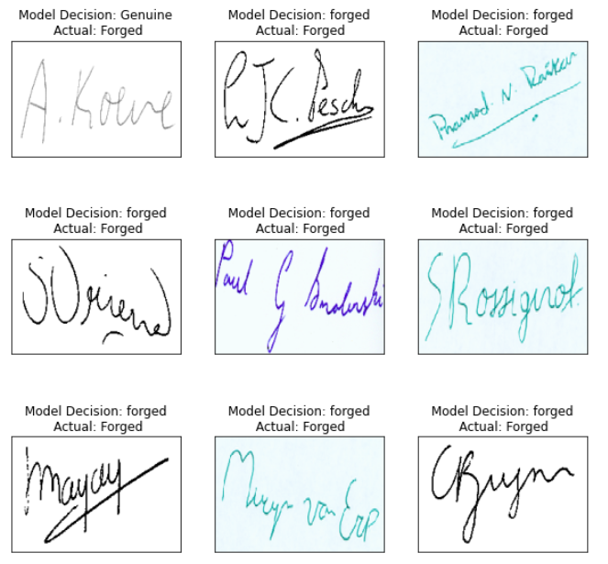
Model Predictions
All the below test signatures are Forged
Overall Test Accuracy : 83.33%

Slide 9
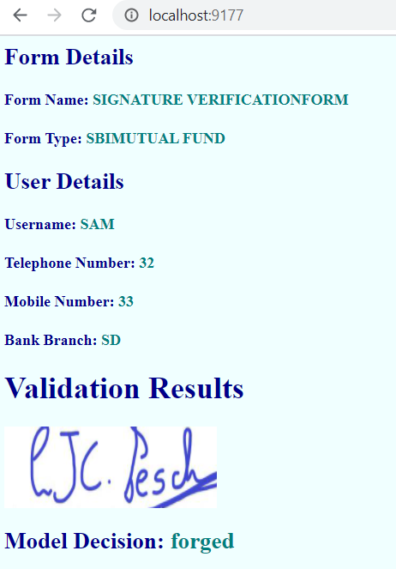
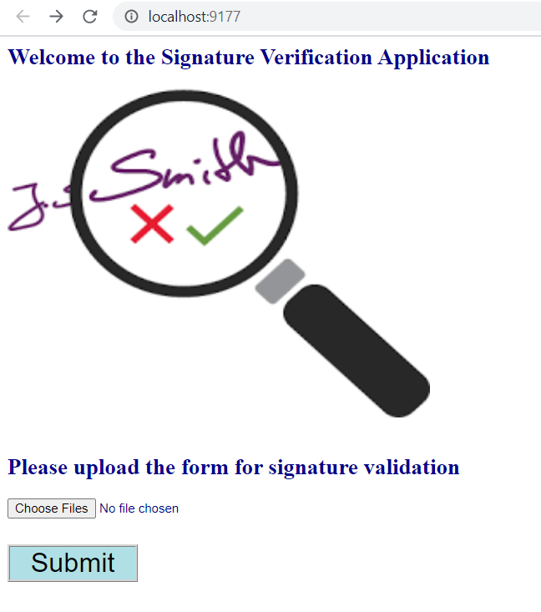

Application Demo
Results: OCR extraction and Image Classification

Slide 10
Limitations
An incorrect signature when classified as correct would result in a greater loss for the bank
A correct signature when classified as incorrect would result in loss of customer trust
Solution
Human based evaluation for signatures marked as questionable depending on predicted probabilities
Penalized Classification to impose an additional cost on the model for making incorrect predictions for the negative class

